Slide 1
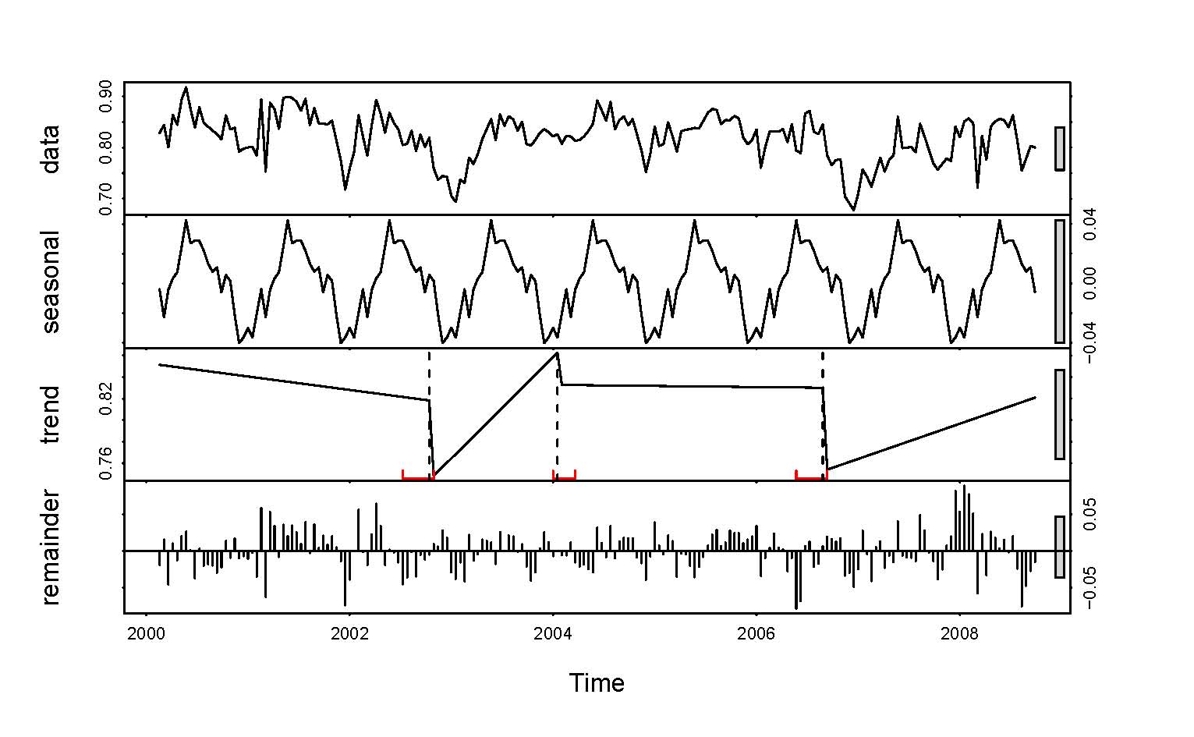
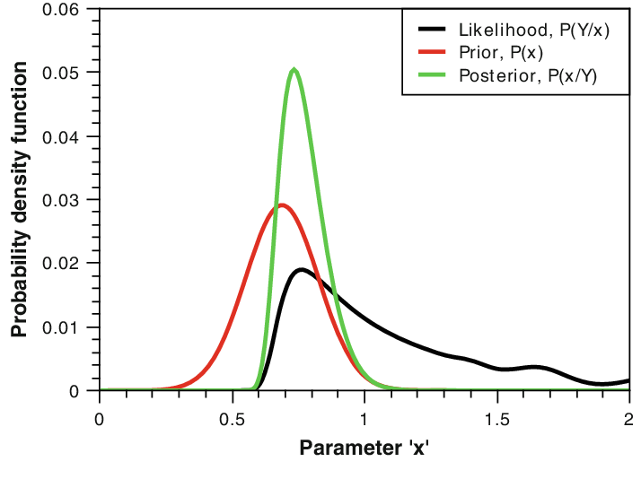
Process Error (true variation) vs. Observation Error (observed minus true)
Bayesian, state-space, time-series creel survey model

Slide 2
Catch = Effort X CPUE
Observation Model(s)
Daily Average Hourly Effort
Census Effort Count (data)
Hourly Effort Residual
d = day
g = gear type
s = section
a = angler group
i = specific hour of day
C = CPUE variable
E = Effort variable
V = vehicle
T = Trailer
$$E_{d,g,s,i}\sim Poisson(λ_{d,g,s}^{E}×ε_{d, g, s,i}^{E})$$
Daily
Average
Hourly
Effort
Proportion
of Anglers
with
Vehicles
Bias term (how many more or less vehicles are counted relative to expected)
Vehicle
Count
(data)
Hourly
Effort
Residual
$$V_{d,g,s,i}\sim Poisson(\sum_{g=1}^{2}{λ_{d,g,s}^{E}×ε_{d, g, s,i}^{E}×P_{g}^{V}×b^{V}})$$
Daily
Average
Hourly
Effort
Proportion
of Anglers
with
Trailers
Bias term (how many more or less trailers are counted relative to expected)
Trailer
Count
(data)
Hourly
Effort
Residual
$$T_{d,g,s,i}\sim Poisson(\sum_{g=1}^{2}{λ_{d,g,s}^{E}×ε_{d, g, s,i}^{E}×P_{g}^{T}×b^{T}})$$

Slide 3
Catch = Effort X CPUE
Proportion
of Anglers
with
Vehicles
d = day
g = gear type
s = section
a = angler group
i = specific hour of day
C = CPUE variable
E = Effort variable
V = vehicle
T = Trailer
Number
of Anglers
in Group
Observation Model(s)
Angler Group number of Vehicles (data)
$$V_{a,g}\sim Binomial(P_{g}^{V},A_{a,g})$$
Proportion
of Anglers
with
Trailers
Number
of Anglers
in Group
Angler Group number of Trailers (data)
$$T_{a,g}\sim Binomial(P_{g}^{T},A_{a,g})$$

Slide 4
Catch = Effort X CPUE
Daily Average Hourly Effort
Census Effort Count (data)
Hourly Effort Residual
Observation Model*
$$E_{d,g,s,i}\sim Poisson(λ_{d,g,s}^{E}×ε_{d, g, s,i}^{E})$$
*likelihoods for index effort counts not shown
d = day
g = gear type
s = section
a = angler group
i = specific hour of day
C = CPUE variable
E = Effort variable

Slide 5
Catch = Effort X CPUE
Daily Average Hourly Effort
Hourly Effort Residual
Census Effort Count (data)
Observation Model*
$$E_{d,g,s,i}\sim Poisson(λ_{d,g,s}^{E}×ε_{d, g, s,i}^{E})$$
*likelihoods for vehicles, trailers, and vehicles and trailers per angler are3 not shown
Overdispersion parameter for within-day effort variability
d = day
g = gear type
s = section
a = angler group
i = specific hour of day
C = CPUE variable
E = Effort variable
$$ε_{d, g, s,i}^{E} \sim Gamma(φ^{hour},φ^{hour})$$
Process Model

Slide 6
Catch = Effort X CPUE
Daily Average Hourly Effort
Hourly Effort Residual
Census Effort Count (data)
Observation Model*
$$E_{d,g,s,i}\sim Poisson(λ_{d,g,s}^{E}×ε_{d, g, s,i}^{E})$$
*likelihoods for index effort counts not shown
Overdispersion parameter for within-day effort variability
d = day
g = gear type
s = section
a = angler group
i = specific hour of day
C = CPUE variable
E = Effort variable
$$ε_{d, g, s,i}^{E} \sim Gamma(φ^{hour},φ^{hour})$$
Process Model
Seasonal mean effort
daily effort residual
weekend effect
weekend indicator variable
$$λ_{d,g,s}^{E}=exp⁡(µ_{g,s}^{E}+{Resid}_{d,g,s}^{E}+B1 × w_{d})$$

Slide 7
Catch = Effort X CPUE
Daily Average Hourly Effort
Hourly Effort Residual
Census Effort Count (data)
Observation Model*
$$E_{d,g,s,i}\sim Poisson(λ_{d,g,s}^{E}×ε_{d, g, s,i}^{E})$$
*likelihoods for index effort counts not shown
Overdispersion parameter for within-day effort variability
d = day
g = gear type
s = section
a = angler group
i = specific hour of day
C = CPUE variable
E = Effort variable
$$ε_{d, g, s,i}^{E} \sim Gamma(φ^{hour},φ^{hour})$$
Process Model
Seasonal mean effort
daily effort residual
weekend effect
weekend indicator variable
$$λ_{d,g,s}^{E}=exp⁡(µ_{g,s}^{E}+{Resid}_{d,g,s}^{E}+B1 × w_{d})$$
Effort AR1 coefficient
Effort process error
$${Resid}_{d,g,s}^{E}= φ^{E}∗{Resid}_{d−1,g,s}^{E}+ ε_{d, g, s}^{E}$$

Slide 8
Catch = Effort X CPUE
Daily Average Hourly Effort
Hourly Effort Residual
Census Effort Count (data)
Observation Model*
$$E_{d,g,s,i}\sim Poisson(λ_{d,g,s}^{E}×ε_{d, g, s,i}^{E})$$
*likelihoods for index effort counts not shown
Overdispersion parameter for within-day effort variability
d = day
g = gear type
s = section
a = angler group
i = specific hour of day
C = CPUE variable
E = Effort variable
$$ε_{d, g, s,i}^{E} \sim Gamma(φ^{hour},φ^{hour})$$
Process Model
Seasonal mean effort
daily effort residual
weekend effect
weekend indicator variable
$$λ_{d,g,s}^{E}=exp⁡(µ_{g,s}^{E}+{Resid}_{d,g,s}^{E}+B1 × w_{d})$$
Effort AR1 coefficient
Effort process error
$${Resid}_{d,g,s}^{E}= φ^{E}∗{Resid}_{d−1,g,s}^{E}+ε_{d, g, s}^{E}$$
Effort Process Error SD
$$ε_{d, g, s}^{E}\sim Normal(0, σ^{E})$$

Slide 9
Catch = Effort X CPUE
angler catch (data)
daily CPUE
angler hours fished (data; used as offset)
Observation Model
$$C_{d,g,s,a}\sim Negative Binomial(λ_{d,g,s}^{C}×hrs)$$
d = day
g = gear type
s = section
a = angler group
i = specific hour of day
C = CPUE variable
E = Effort variable

Slide 10
Catch = Effort X CPUE
angler catch (data)
daily CPUE
angler hours fished (data; used as offset)
Observation Model
$$C_{d,g,s,a}\sim Negative Binomial(λ_{d,g,s}^{C}×hrs)$$
Seasonal mean CPUE
daily CPUE residual
d = day
g = gear type
s = section
a = angler group
i = specific hour of day
C = CPUE variable
E = Effort variable
$$λ_{d,g,s}^{C}=exp⁡(µ_{g,s}^{C}+{Resid}_{d,g,s}^{C})$$
Process Model

Slide 11
Catch = Effort X CPUE
angler catch (data)
daily CPUE
angler hours fished (data; used as offset)
Observation Model
$$C_{d,g,s,a}\sim Negative Binomial(λ_{d,g,s}^{C}×hrs)$$
Seasonal mean CPUE
daily CPUE residual
d = day
g = gear type
s = section
a = angler group
i = specific hour of day
C = CPUE variable
E = Effort variable
$$λ_{d,g,s}^{C}=exp⁡(µ_{g,s}^{C}+{Resid}_{d,g,s}^{C})$$
Process Model
CPUE AR1 coefficient
CPUE process error
$${Resid}_{d,g,s}^{C}= φ^{C}∗{Resid}_{d−1,g,s}^{C}+ ε_{d, g, s}^{C}$$

Slide 12
Catch = Effort X CPUE
angler catch (data)
daily CPUE
angler hours fished (data; used as offset)
Observation Model
$$C_{d,g,s,a}\sim Negative Binomial(λ_{d,g,s}^{C}×hrs)$$
Seasonal mean CPUE
daily CPUE residual
$$λ_{d,g,s}^{C}=exp⁡(µ_{g,s}^{C}+{Resid}_{d,g,s}^{C})$$
d = day
g = gear type
s = section
a = angler group
i = specific hour of day
C = CPUE variable
E = Effort variable
L = total fishing hours
Process Model
CPUE AR1 coefficient
CPUE process error
$${Resid}_{d,g,s}^{C}= φ^{C}∗{Resid}_{d−1,g,s}^{C}+ ε_{d, g, s}^{C}$$
CPUE Process Error SD
$$ε_{d, g, s}^{C}\sim Normal(0, σ^{C})$$
Catch = Effort X CPUE
Total catch (estimate)
daily CPUE
Total hours fished
$C_{d,g,s,a}$ $\sim$ $Poisson(λ_{d,g,s}^{C}×{ λ}_{d,g,s}^{E} × L_{d})$

Slide 13





Priors
$${Resid}_{d=0, g, s}^{C}\sim Normal\left(0,1\right)$$
$${Resid}_{d=0, g, s}^{E}\sim Normal(0,1)$$
$$µ_{g,s}^{C}\sim Normal(log⁡(0.05),1.5)$$
d = day
g = gear type
s = section
a = angler group
i = specific hour of day
C = CPUE variable
E = Effort variable
$$µ_{g,s}^{E}\sim Normal(log⁡(10),2)$$
$$φ^{C}\sim Uniform(−1,1)$$
$$φ^{E}\sim Uniform(−1,1)$$
$$σ^{C}\sim Cauchy(0,1)$$
$$σ^{E}\sim Cauchy(0,1)$$
$${φ^{hour}}^{−2}\sim Cauchy(0,1)$$
$$B1\sim Normal(0,5)$$

